Slide 1
Session 3
Fab Finance

Slide 2
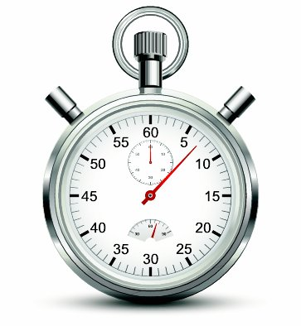
Finance Countdown
You will be shown 3 calculation questions on the screen.
You need to complete them before the countdown music stops
Get Ready.....

Slide 3
A business has fixed costs of £50,000 a year, variable costs of £5 and a selling price of £12. How many units need to be sold to break-even?
£7,143
A business needs to sell 5,000 products to break-even. The contribution per unit is £1.50 How much are the fixed costs?
£7,500

Slide 5
1
2
3
4
5
Revenue
Profit
Variable Costs
Bank Loan
Trade credit
6
Break Even
Use space bar (or click mouse)
to scroll through bingo balls
7
Dividend
Cash flow
8
Contribution
9
Share Capital
10
Fixed Costs
11
12
Margin of Safety
Revenue
Profit
Variable Costs
Bank Loan
Trade credit
Break Even
Dividend
Cash flow
Contribution
Share Capital
Fixed Costs
Margin of Safety
let’s play
B
I
N
G
O

Slide 6
Watch the video clip and note down the costs of the 4 items listed on pg 13

Slide 7
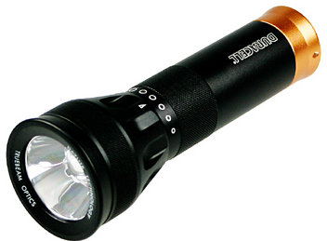
Watch the video clip and note down the missing costs
Item | Cost
Tarpaulin
Torch
Groundsheet
Mug
Peg Bag | £0.49
Tent Pegs | £0.99
Mallet | £1.99
Total costs to put kit together

Slide 9
Watch the video clip and note down the missing costs
Item | Cost
Tarpaulin
Torch
Groundsheet
Mug
Peg Bag | £0.49
Tent Pegs | £0.99
Mallet | £1.99
Total costs to put kit together
£3.89
£3.09
£1.61
£0.59
Are these costs fixed or variable?
£12.65

Slide 10
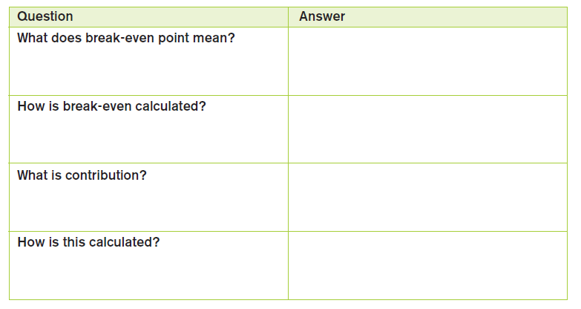
Breaking Even at Denkit
The output at which total costs equal total revenue. Neither a profit or a loss is made.
Fixed costs/contribution per unit
The portion of the selling price that contributes towards fixed costs and then profit.
Selling price per unit – variable cost per unit

Slide 11
Calculate the Break-Even Point
Sales Price per unit = £20.00
Variable Cost per unit = £12.65
Contribution per unit =
£7.35
Total Fixed Costs £30,000
per annum
Contribution per unit (from above) =
Break Even Output =
4082 den kits
£7.35

Slide 12
The “margin of safety”
The difference between actual output and the breakeven output

Slide 13
“Margin of safety” for Denkit?
Expected Sales = 4750
Breakeven output 4082
Margin of safety =
668 Denkits

Slide 14
Calculate the total profit made by Joanna and Kay if they manage to meet their forecast of 4750 sales in their first year Assume that fixed costs are £2000 higher than expected.
Total contribution
Contribution per unit x total
number of units sold
£7.35 x 4750 = £34912.50
Total profit
Total Contribution – Fixed Costs
£34912.50 - £32000 = £2912.50

Slide 15
Examiners Tip
Calculations
Calculations will not appear in every paper but you must be prepared to answer them if they do. They are a route to easy marks. Start with stating the formula and show all of your working. Even if your ultimate answer is wrong you are likely to be awarded marks for the working out.

Slide 16
Improving Profits

Slide 17
Identify three ways in which Joanna and Kay could increase the level of profit they make.
Method | How does this increase profit? | Caution because….
Reduce fixed costs such as rent, labour
Reduces the businesses total costs
It may reduce capacity or storage space, leading to stock or production issues
Reduce variable costs of raw materials
Increases contribution per unit. More total contribution is earned from same sales
Could reducing cost of components of kit lead to quality problems?
Change price
This could increase revenue, without having a major effect on costs.
If price is increased, might units sold fall by a lot?
If price is cut, will enough extra sales be obtained?

Slide 18
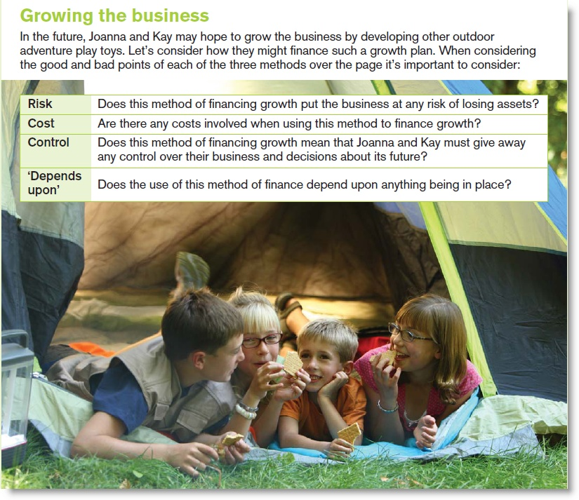

Slide 19
Girls
Bank Loan
Risk
Cost
Boys
Share Capital
Risk
Cost
Control
Control
Depends on
Depends on
May need to offer ‘collateral’ that could be repossessed if repayments not made
Not as risky as loan – no repayments and no ‘collateral’ needed.
Interest payments need to be made. These may increase if interest rates go up
There are some transaction costs in issuing shares and shareholders will expect a ‘dividend’
There is no loss of control. As long as repayments are made the bank will not interfere.
In this case they are unlikely to lose control, but ‘plc’s’ may lose control in ‘hostile takeovers’ where a rival buys up the majority of shares
Does the business have collateral to offer? Can it’s cashflow cope with the repayments?
Is the investment attractive to shareholders? Can they find investors they feel they can work with?

Slide 20
Compare and contrast these student answers
“Explain one problem that may arise if Joanna and Kay use a cheaper supplier for the contents of The Den Kit.” (3 marks).

Slide 21
Have a go at this question
One disadvantage Joanna and Kay may face is that they may sell shares to an investor who disagrees with how they want to take the business forward. As a result, there may be arguments over what would be the best new toys to develop. This could lead to delays in creating new products to sell to toy retailers, which would result in Joanna and Kay failing to expand the business as quickly as they would like.

Slide 22
Examiners Tip
Making a choice
At the end of section A there is always a question where you will be encouraged to make a choice between two options and then explain why you made your decision. There is no right or wrong answer! You will be able to well by just focusing your answer around one of the choices rather than both! However, to score top marks you must add plenty of context to your answer and include some kind of balance preferably in a conclusion at the end of your response

